Slide 1

Fundamentals of Politics Research Lecture 11 (2020-21) The ethical study of politics Dr Adrian Blau

Slide 2
Trust
When an author reports (alleged) facts, readers should be able to trust this.
FFP – three unethical practices:
Fabrication
Falsification
Plagiarism

Slide 3

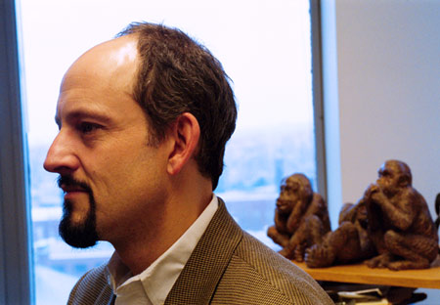
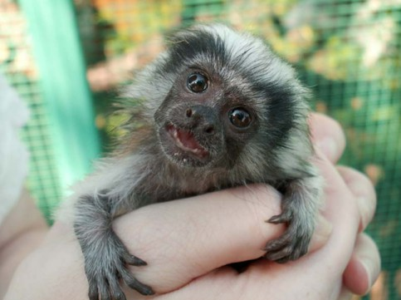
Fabrication?
Baby cotton-top tamarin (Saguinus oedipus)

Slide 4
Plagiarism

Slide 5
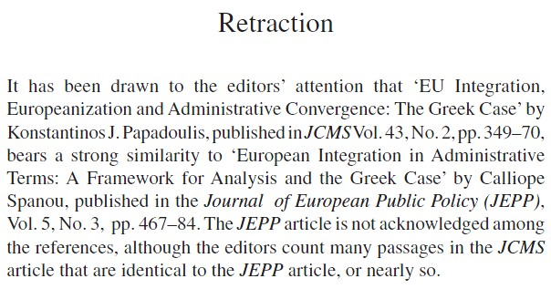
Journal of Common Market Studies (2005)

Slide 6
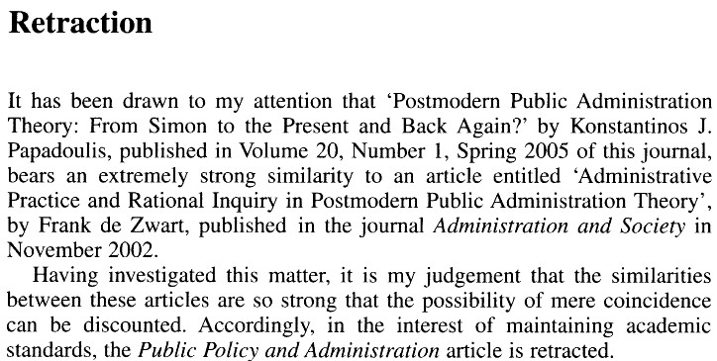
Public Policy and Administration (2005)

Slide 7
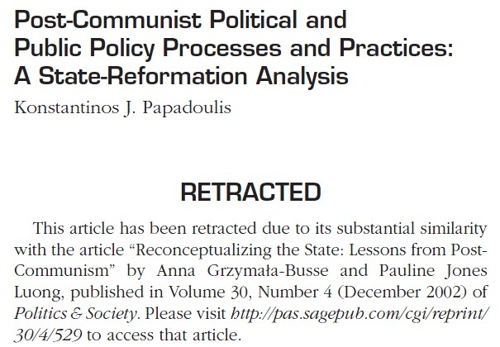
East European Politics and Societies (2005)

Slide 8
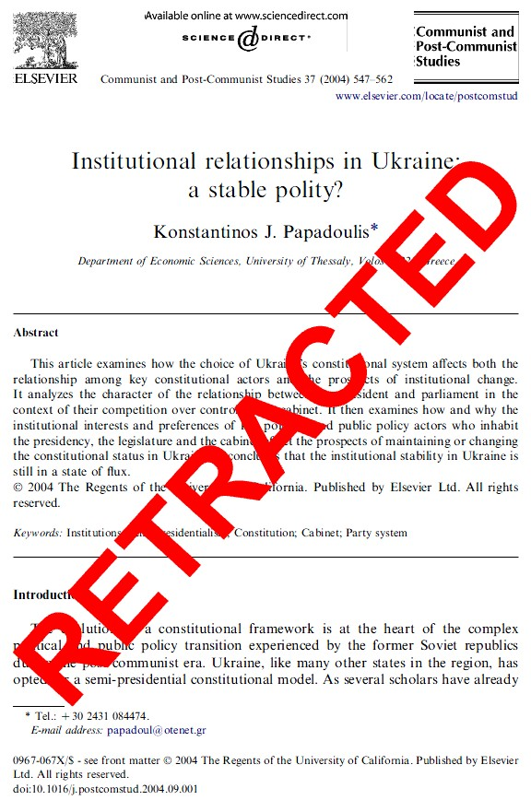

Slide 9
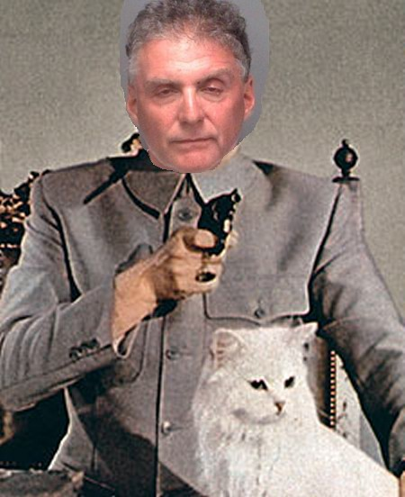
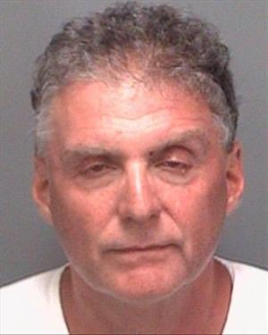

Slide 10
‘Little murders’
Zigmond and Fischer (2002).
More like little wounds which add up to a murder.
They pollute the research environment and affect what you think.

Slide 11
Sloppy referencing
Approach to ‘Habermas’ (Blau 2011).
Failure to understand Foucault (BlauBlog: parts 1 and 2).
Bad academic convention about page numbers.
Herman Cappelen: ‘a cognitive disaster caused by an irresponsible expert community’ (2013, 45).

Slide 12
Example: Caulfield and Hill
Use ‘deduction’ and ‘induction’ in two ways.
Wrong ‘deduction’ that positivists in social science copy methods of natural sciences.
Falsely claim that positivist research:
is quantitative;
rejects interpretation;
denies human agency.

Slide 13
Caulfield and Hill (continued)
Hardly anything in this account is correct, and much is seriously misleading.
Are any positivists this stupid any more?
‘the three key theories of knowledge’ (positivist, interpretivist, poststructuralist).
But as many people don’t fit into categories 1-3, Caulfield and Hill need to rethink.
Don’t be too trusting!

Slide 14
Integrity and impartiality
An attachment to good answers whether or not they are one’s own answers.
‘I would rather be right than first.’
Willingness to be wrong: logic and disposition of falsification.
Darwin.

Slide 15
Integrity
KKV and K&W on scepticism, Elster on the need to ‘think against yourself’.
This applies to political theorists too.
Beware of being the slave of a theory or an ideology.
Harder to climb down after defending a position in public.

Slide 16
Mindset: key questions
Do I trust the data? Do I trust these intuitions?
How can I test these claims, e.g. objections, counter-examples, or other interpretations?
Am I or these authors trapped by theories?
How confident am I in these findings? How firmly should I present my conclusions? How generalisable are these claims?
Are we even asking all the right questions in the first place?
In essays too!

Slide 17
Self-centredness
Beware academics who translate personal likings and dislikings (or strengths and weaknesses) into general methodological prescriptions.
Don’t do this yourself!
Don’t be too sceptical of other disciplines or too proud of your disciplines.

Slide 18
Well-roundedness & reflectivity
‘technically competent barbarians’ who are ‘methodologically sophisticated at exploring … issues that do not matter’ (Labaree 2010, 19; Rothstein 2005, 8-10).
Methods should not dictate what problems we study (Macfarlane 2009, 126-8).
But we need a division of labour.
And we need an emphasis on asking important questions.

Slide 19
Module conclusions
Don’t be too trusting. Be critical!
Intellectual progress comes as much from our questions (and concepts) as our answers.
Rigorous, sceptical testing helps us suggest good answers. Mindset, not just rules.
Understanding the fundamentals of politics research will help you on other modules.

Slide 20
A second-year student
‘Last year I was like sitting in the [4SSPP101] lectures and literally I was thinking “what is that?” and this year I need it in everything.’
‘Every single lecture I’m now like “can you criticise the methodology”, and oh my god it’s so useful this year.’

Slide 21
Extra references
Blau, Adrian. 2011. Rationality and deliberative democracy: a constructive critique of John Dryzek’s democratic theory, Contemporary Political Theory 10:1, 37-57.
Cappelen – see week 11 reading list.
Caulfield and Hill – see week 5 seminar, on KEATS.
Labaree, David. 2010. ‘The lure of statistics for educational researchers’, in Educational Research: The Ethics and Aesthetics of Statistics, ed. Paul Smeyers and Marc Depaepe. Dordrecht: Springer, 13-25.
Rothstein, Bo. 2005. ‘Is political science producing technically competent barbarians?’, European Political Science 4:1, 3-13.

